Slide 1




GEMOC modeling crash course
---An introduction to EMF tooling ---
2017
Didier Vojtisek (Inria)
http://people.rennes.inria.fr/Didier.Vojtisek/
Didier.vojtisek@inria.fr
Benoit Combemale (Inria & Univ. Rennes 1)
http://people.irisa.fr/Benoit.Combemale
benoit.combemale@irisa.fr
@bcombemale

Slide 2
Course main purpose
see how EMF+GEMOC technologies helps to (semi-automatically) build the tooling for a DSL IDE

Slide 3

Course content
Part 1. General introduction
Modeling/Language
DSL
Part 2.a. Technology introduction
Eclipse
Ecore
OCL
Xtext
Sirius
K3/Melange
GEMOC model debugger
Part 2.b. Hands on
Finite State Machine example
Part 3. Scaling up - Going further
Concurrency
Coordination

Slide 5
What is a language?
« A system of signs, symbols, gestures, or rules used in communicating »
« The special vocabulary and usages of a scientific, professional, or other group »
« A system of symbols and rules used for communication with or between computers. »

Slide 6
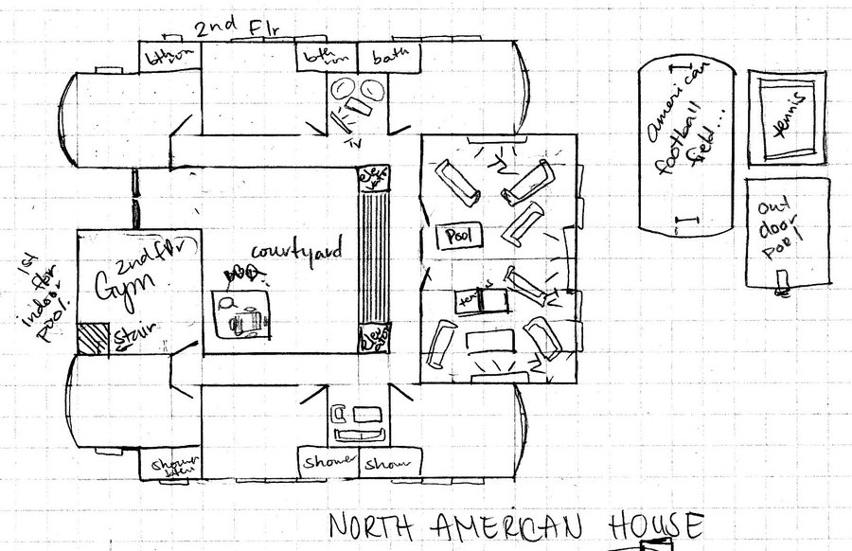
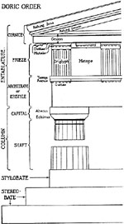
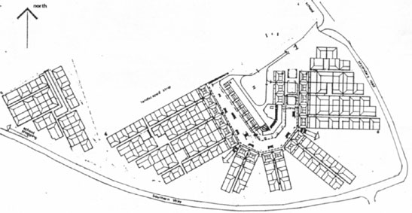
Architecture
Architecture

Slide 7
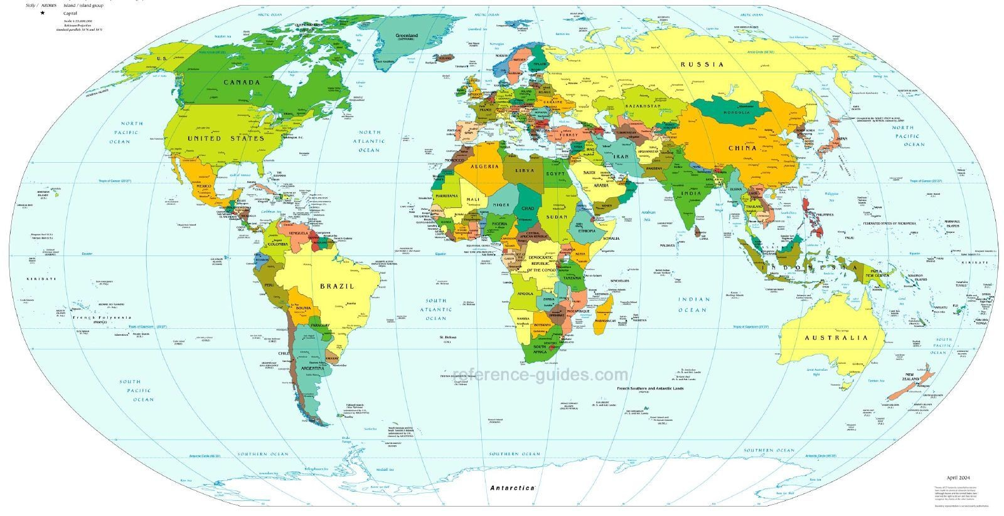
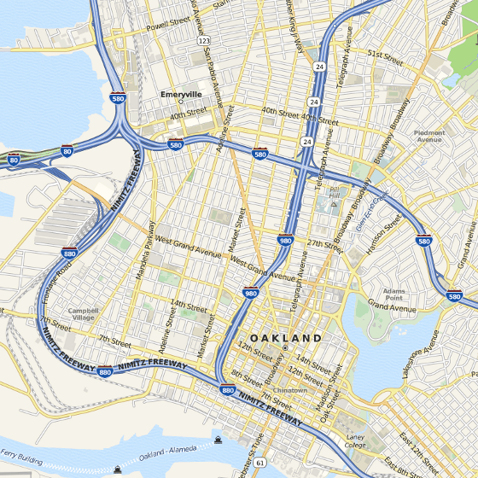
Cartography
Cartography

Slide 8
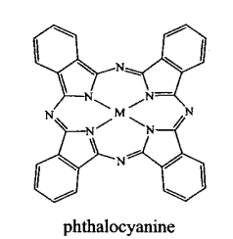
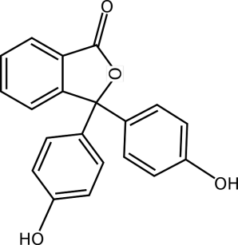
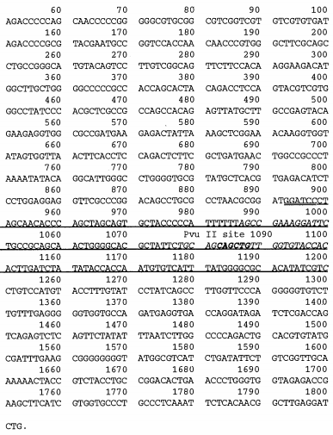
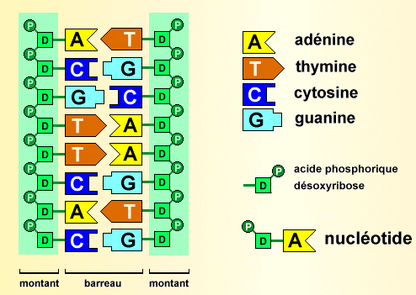
Biology
Biology

Slide 9
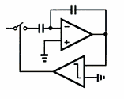
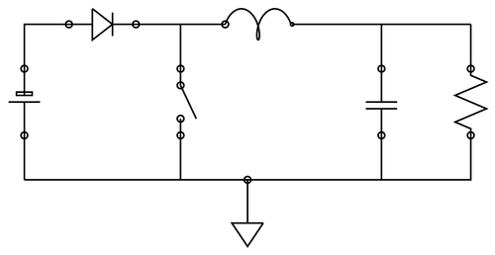
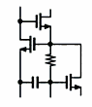
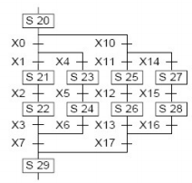
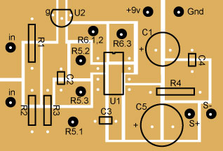
Electronics
Electronics

Slide 10
In Software Engineering
« Languages are the primary way in which system developers communicate, design and implement software systems »

Slide 11
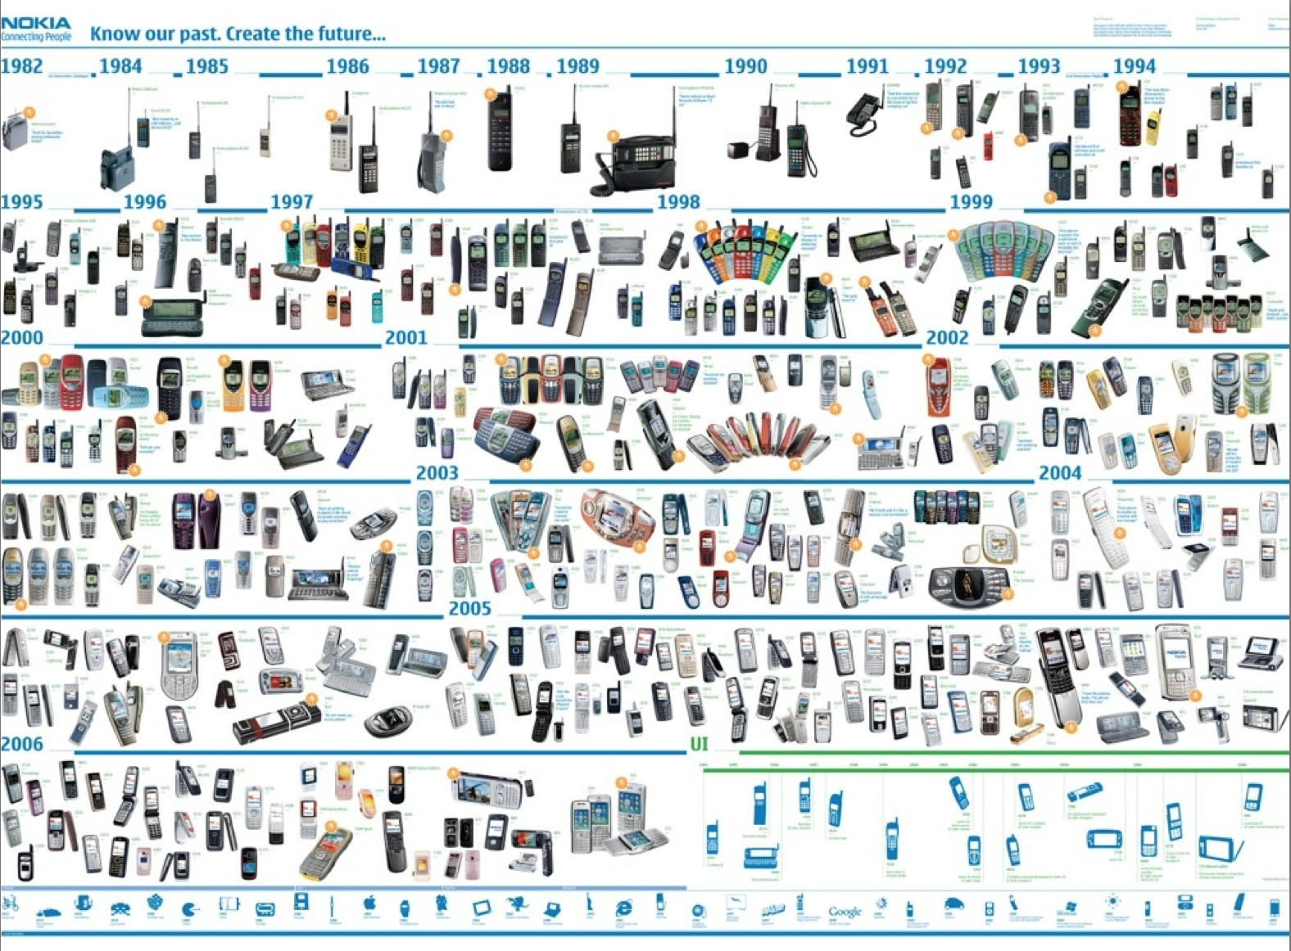





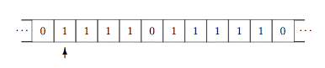
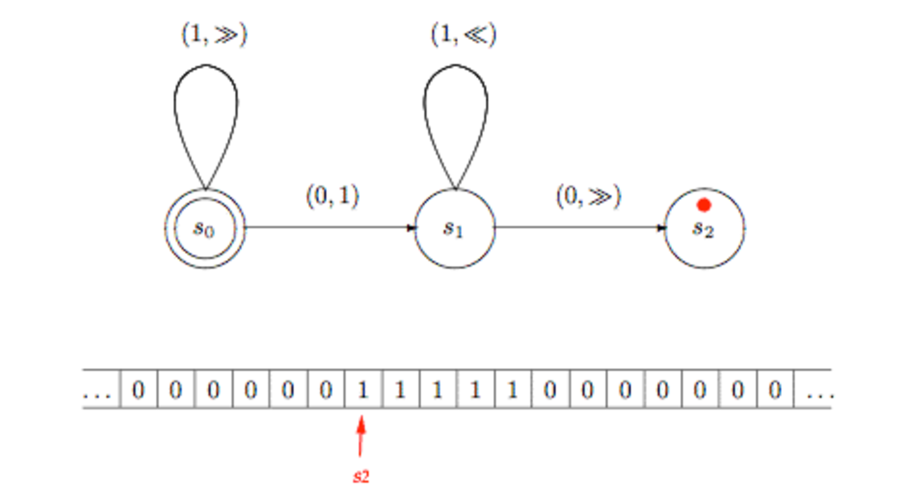
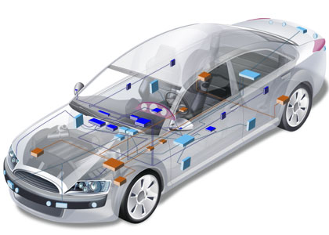

General Purpose
Languages
Assembly ?
COBOL ? LISP ? C ? C++ ?
Java? PHP ? C# ? Ruby ?
Notes:
http://plato.stanford.edu/entries/turing-machine/

Slide 12
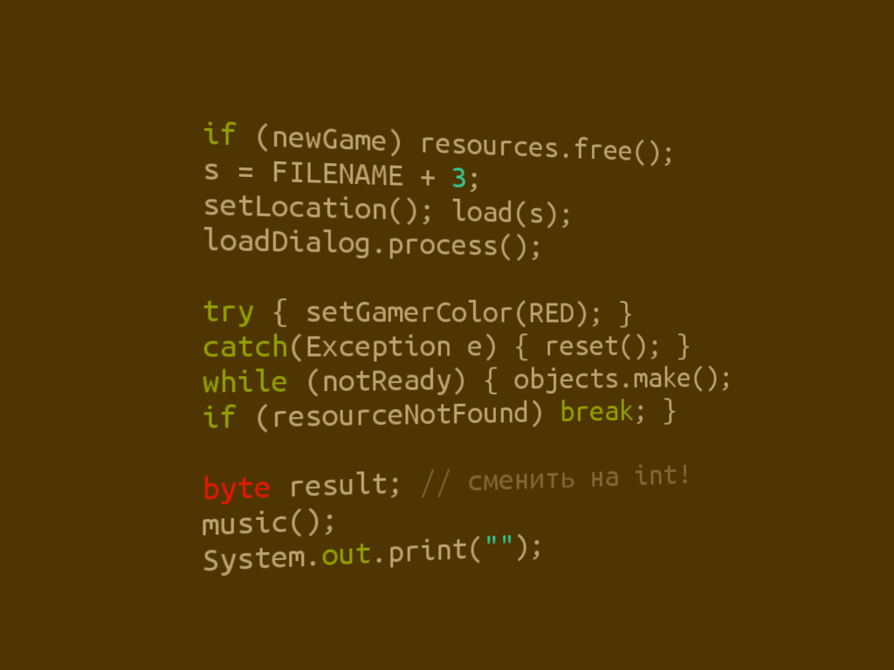
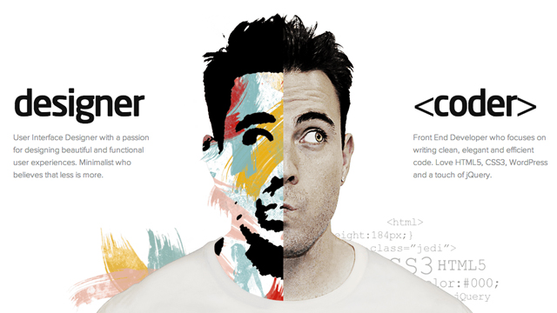
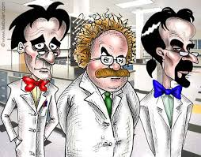

Limits of General Purpose Languages (1)
Abstractions and notations used are not natural/suitable for the stakeholders

Slide 13

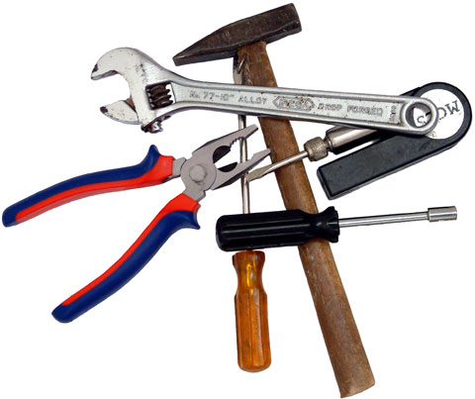
Limits of General Purpose Languages (2)
Not targeted to a particular kind of problem, but to any kinds of software problem.

Slide 14
Domain Specific Languages
Targeted to a particular kind of problem, with dedicated notations (textual or graphical), support (editor, checkers, etc.)
Promises: more « efficient » languages for resolving a set of specific problems in a domain

Slide 15
Domain Specific Languages (DSLs)
Long history: used for almost as long as computing has been done.
You’re using DSLs in a daily basis
You’ve learnt many DSLs in your curriculum
Examples to come!

Slide 16
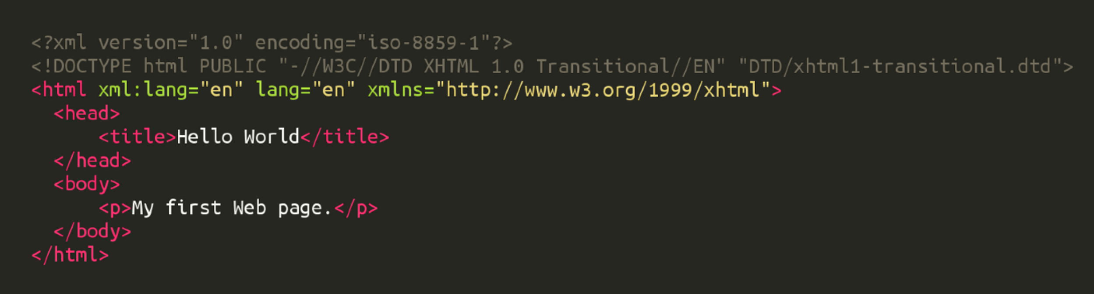
HTML
Domain: web (markup)

Slide 17
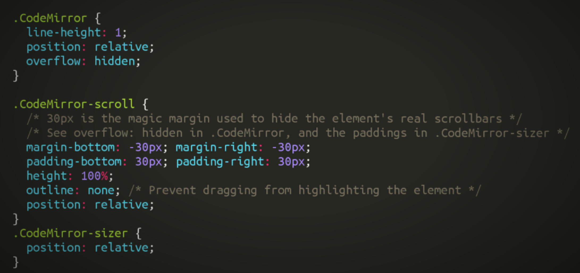
CSS
Domain: web (styling)

Slide 18
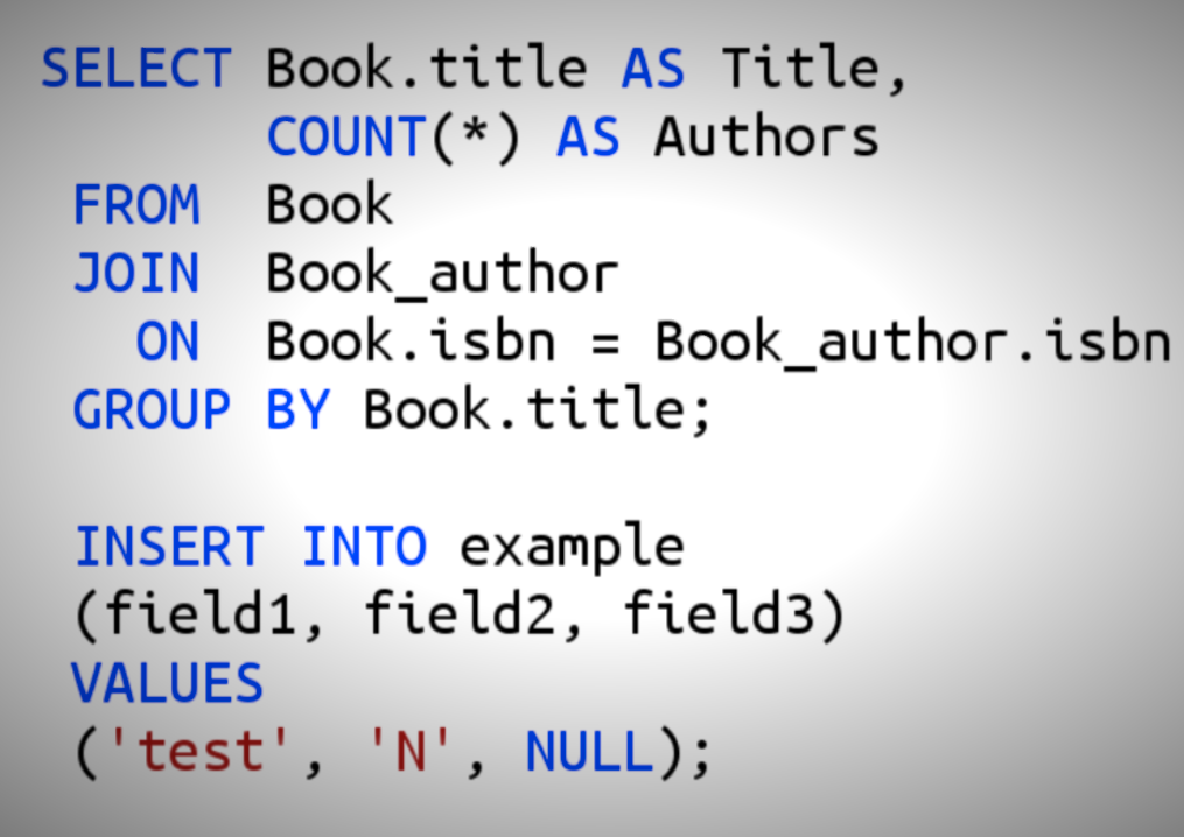
SQL
Domain: database (query)

Slide 19
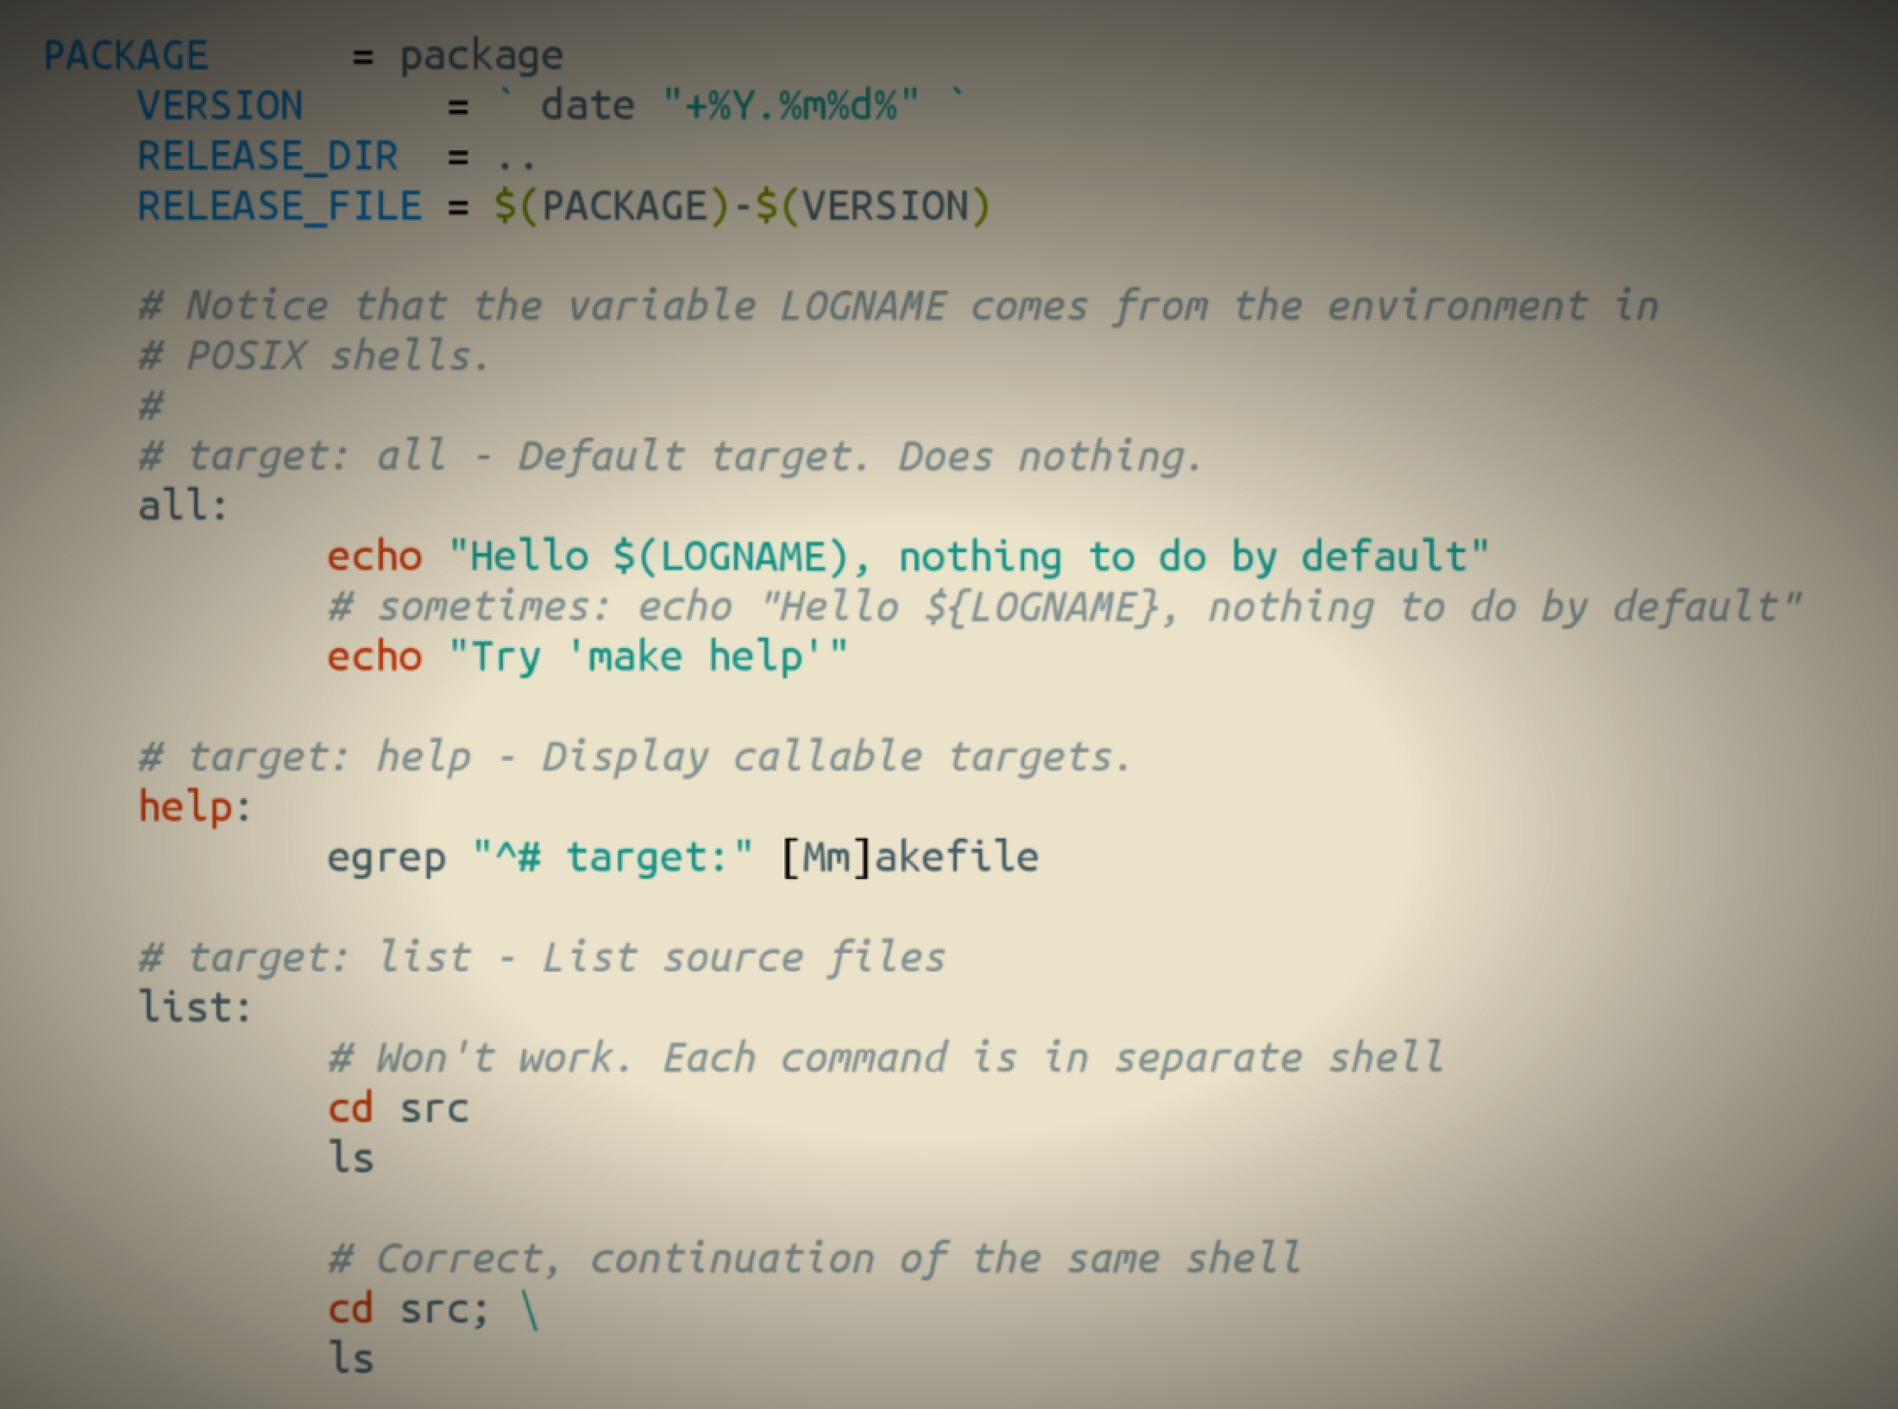
Makefile
Domain: software building

Slide 20
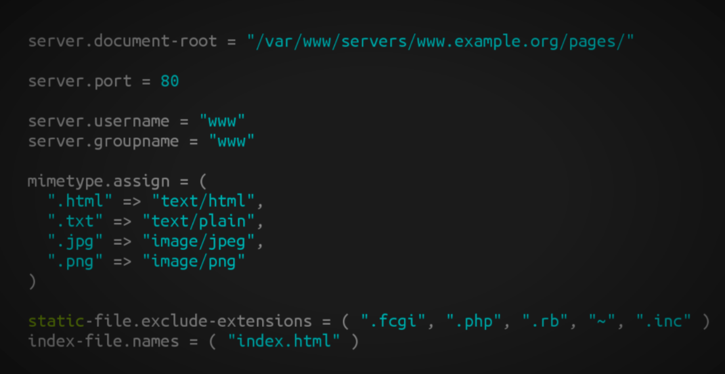
Lighthttpd configuration file
Domain: web server (configuration)

Slide 21
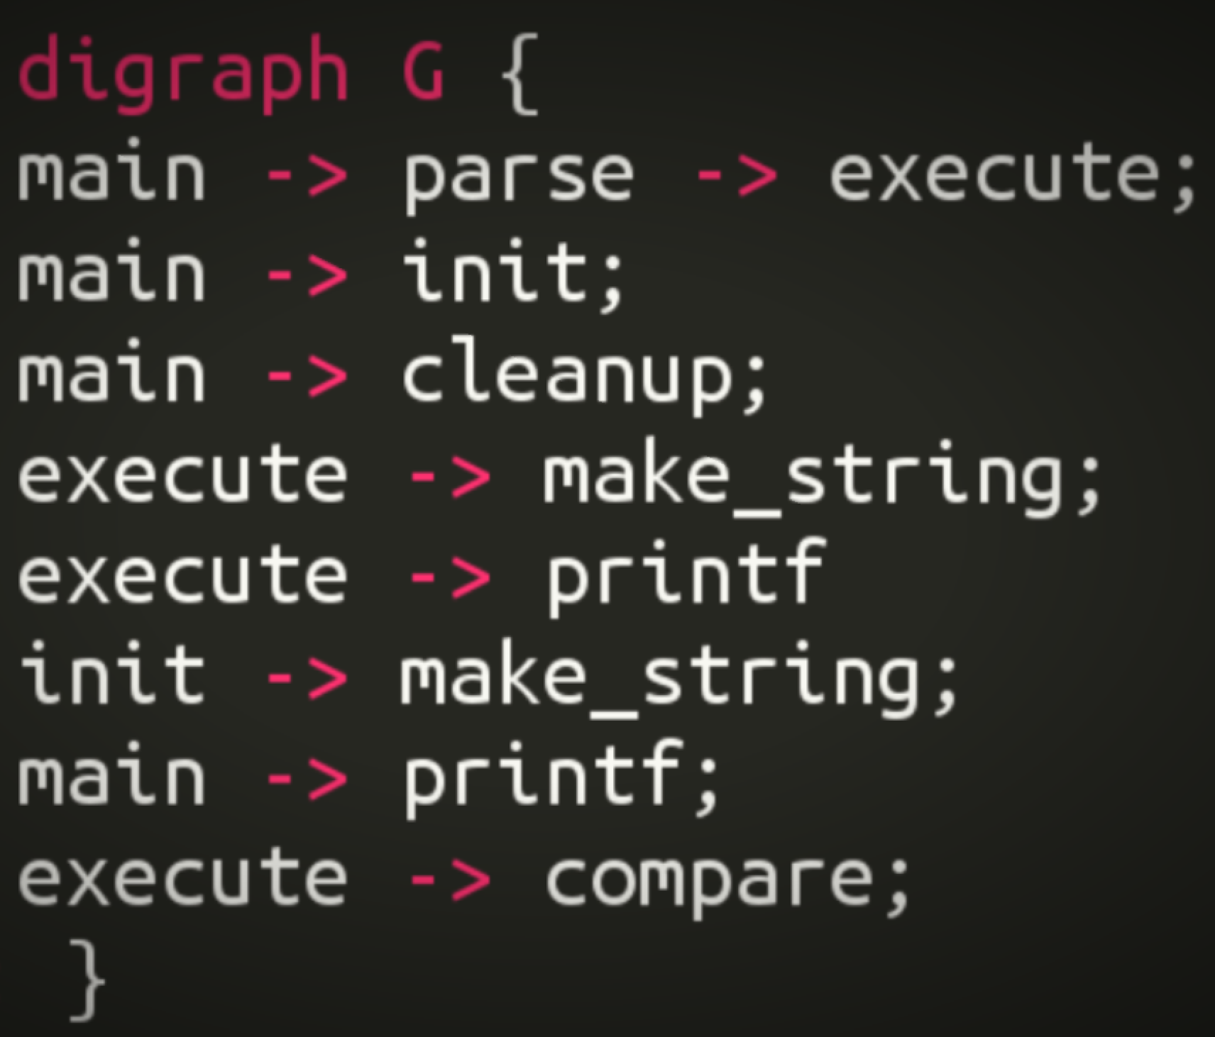
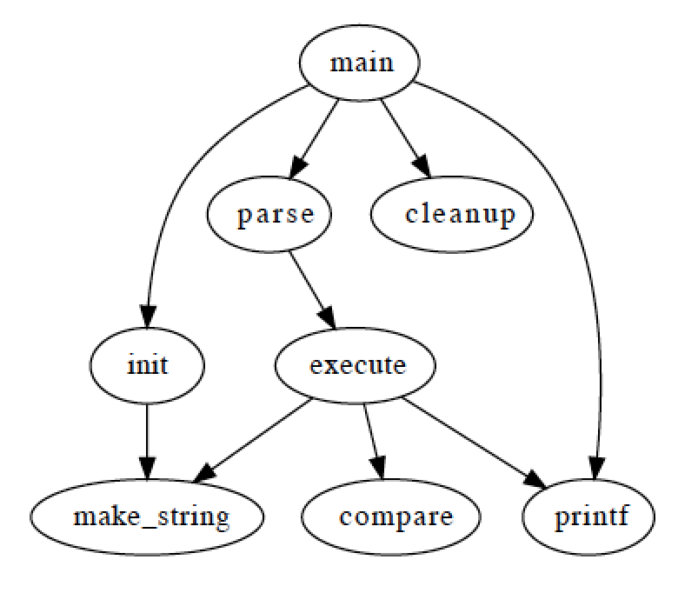
Graphviz
Domain: graph (drawing)

Slide 22
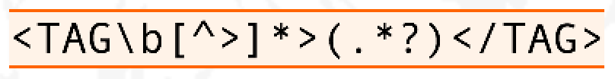
Regular expression
Domain: strings (pattern matching)

Slide 23
OCL
self.questions->size
self.employer->size
self.employee->select (v | v.wages>10000 )->size
Student.allInstances
->forAll( p1, p2 |
p1 <> p2 implies p1.name <> p2.name )
Domain: model management

Slide 24
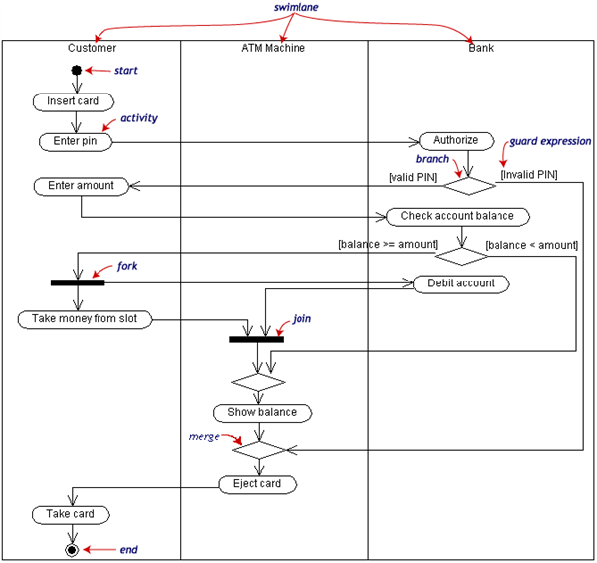
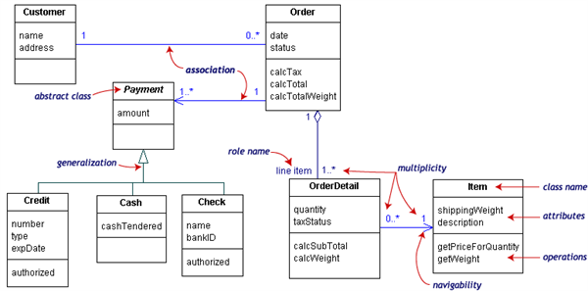
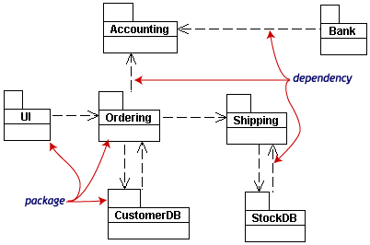
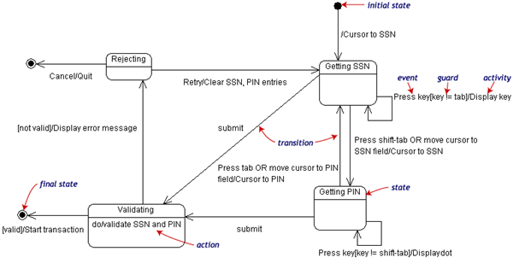
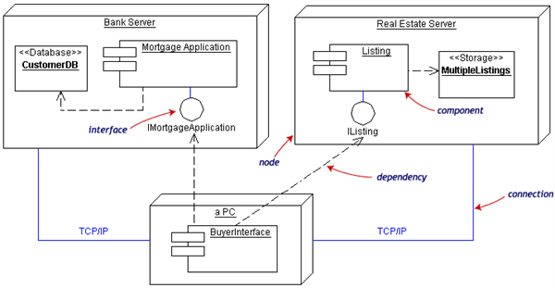
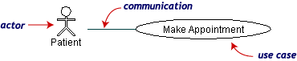
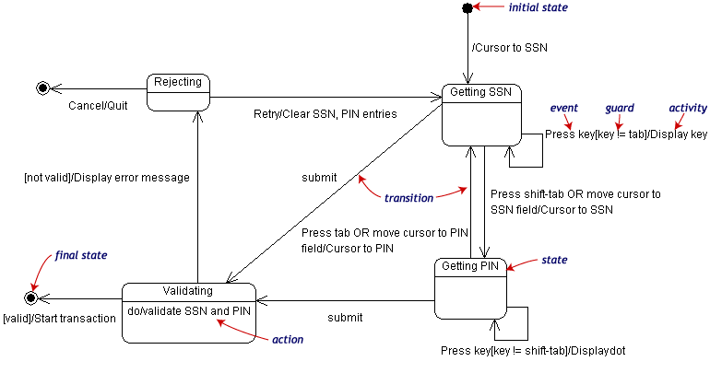
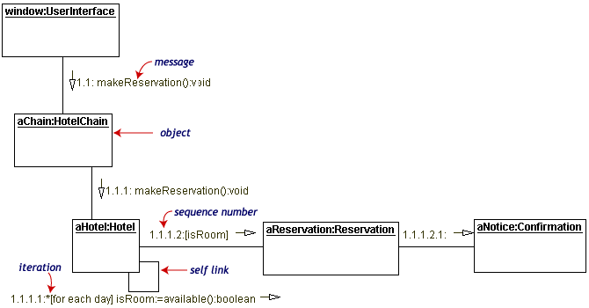
UML can be seen as a collection of domain-specific modeling languages
Structural
Behavioral

Slide 25
Defining languages

Slide 26
Software Language Engineering (SLE)
Application of systematic, disciplined, and measurable approaches to the development, deployment, use, and maintenance of software (domain-specific) languages
Supported by various kind of "language workbench"
Eclipse EMF, xText, Sirius, Melange, GEMOC, Papyrus
Jetbrain’s MPS
MS DSL Tools
Etc.
Various shapes and ways to implement software languages
External, internal or embedded DSLs, Profile, etc.
Grammar, metamodel, ontology, etc.
More and more literature, a dedicated Intl. conference (ACM SLE, cf. http://www.sleconf.org)…

Slide 27
Comparing Abstract Syntax Systems
Technology #1
(formal grammars
attribute grammars,
etc.)
Technology #2
(MOF + OCL)
Technology #3
(XML Meta-Language)
Technology #4
(Ontology engineering)
M³
A XML DTD
Or Schema
EBNF
MOF
Upper Level
Ontologies
M²
Pascal Language
Grammar
The UML
meta-Model
A XML
document
A XML DTD
or Schema
KIF
Theories
M¹
+Description
Logics
+Conceptual
Graphs
+etc.
A specific
Pascal Program
A Specific
UML Model
A XML
document
+ Xlink, Xpath, XSLT
+ RDF, OIL, DAML
+ etc.
A specific
execution
of a Pascal
program
A Specific
phenomenon
corresponding to
a UML Model
[XMI=MOF+XML+OCL]
(From J. Bézivin)

Slide 28
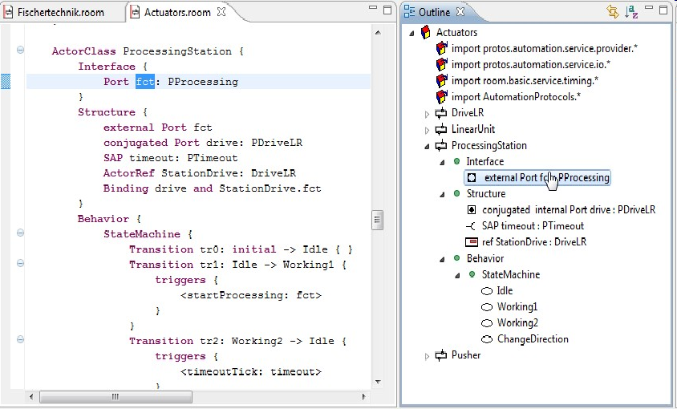
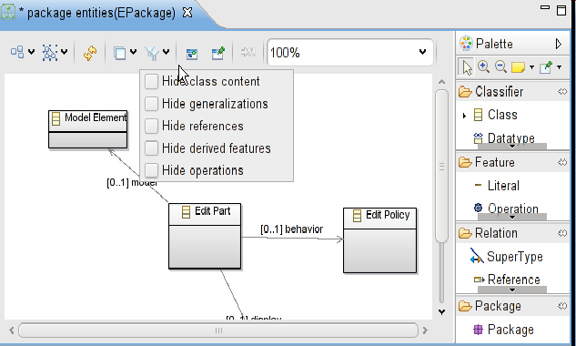
Bridging grammar/model space

Slide 29
Domain-Specific Languages (DSLs)
Targeted to a particular kind of problem, with dedicated notations (textual or graphical), support (editor, checkers, etc.)
Promises: more « efficient » languages for resolving a set of specific problems in a domain

Slide 30
Model-Driven Engineering (MDE)
Engineering Modeling Languages: Turning Domain Knowledge into Tools, by Benoit Combemale, Robert B. France, Jean-Marc Jézéquel, Bernhard Rumpe, Jim R.H. Steel, and Didier Vojtisek. Chapman and Hall/CRC, pp.398, 2016. Companion website: http://mdebook.irisa.fr

Slide 31
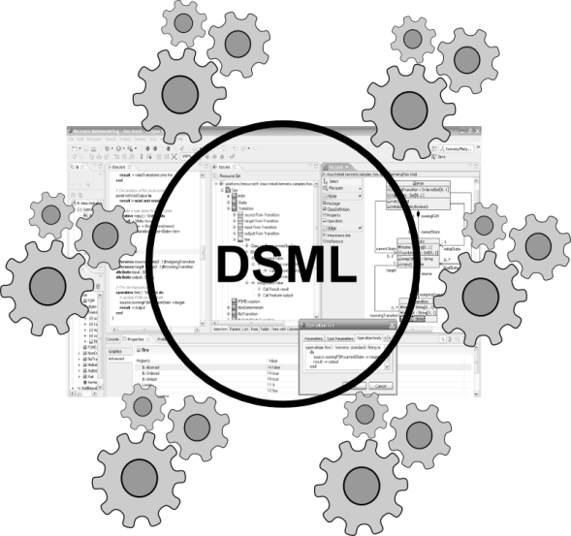
Model-Driven Engineering (MDE)
Editors
(textuals, graphicals, …)
Checkers
(static & dynamics)
Compilers
Test generators
Translators
Simulators
Code generators
Analyzers
Refactoring
Etc.
Engineering Modeling Languages: Turning Domain Knowledge into Tools, by Benoit Combemale, Robert B. France, Jean-Marc Jézéquel, Bernhard Rumpe, Jim R.H. Steel, and Didier Vojtisek. Chapman and Hall/CRC, pp.398, 2016. Companion website: http://mdebook.irisa.fr

Slide 32
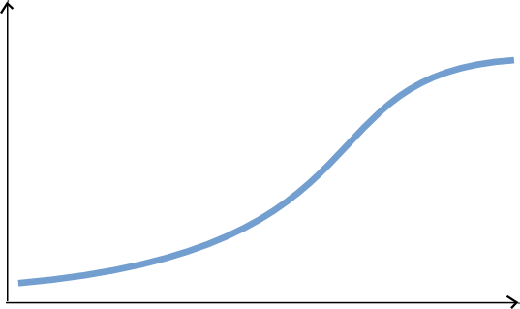
Complete environment
Large scale deploiement and distribution
Rich modeling tooling
(graphical, textuals, forms)
Live Collaboration « à la google doc »
Customisations
Large models
Parametric code generators
Documentation genetators
Analysis tools
Mission critical : tested and valided !
You are here
Lot of work
Some hours
Features

Slide 33
Automatisation facile
Basic editing features
Reflective and dynamic editors
Déploiement à travers le repo source (GIT..)
Collaboration classique
EMF compare
Code generation!
Lot of work
You are her
Some hours
Features

Slide 34
Content of the course
Introduction to MDE (from modeling to metamodeling)
Domain-Specific Languages
Model management (static analysis, code generators)
Experimentations with the Eclipse Modeling Framework (incl. Ecore and OCL), Xtext, Sirius and Xtend

Slide 35
You will learn how to
Automatically translate abstract design models to executable code, test cases and documentation
Automatically manipulate your model/code to analyze and refactor it
Build or customize your own abstractions, or even software languages and development environments, to build complex, domain-specific, software-intensive systems
Eventually limit the accidental complexity of industrial processes developments

Slide 36
Additionally, you will also
Demystify language formalisms, paradigms and principles (Grammar vs 'Meta'-models)
Have a deeper insight on some of them
Manage the industrial complexity of developments and associated toolchains

Slide 37
Eclipse plugin structure and lifecycle
integrated development environment with base workspace and an extensible plug-in system
Contribute to existing IDE
Open structure with thirdparty contributions
Update site, market place, …
Or create your own application
Rich Client Platform (RCP) for developing general purpose applications
-> component based / service base approach
Equinox : an implementation of OSGI core framework
Ie. Pick in the huge community plugins to build your application

Slide 38
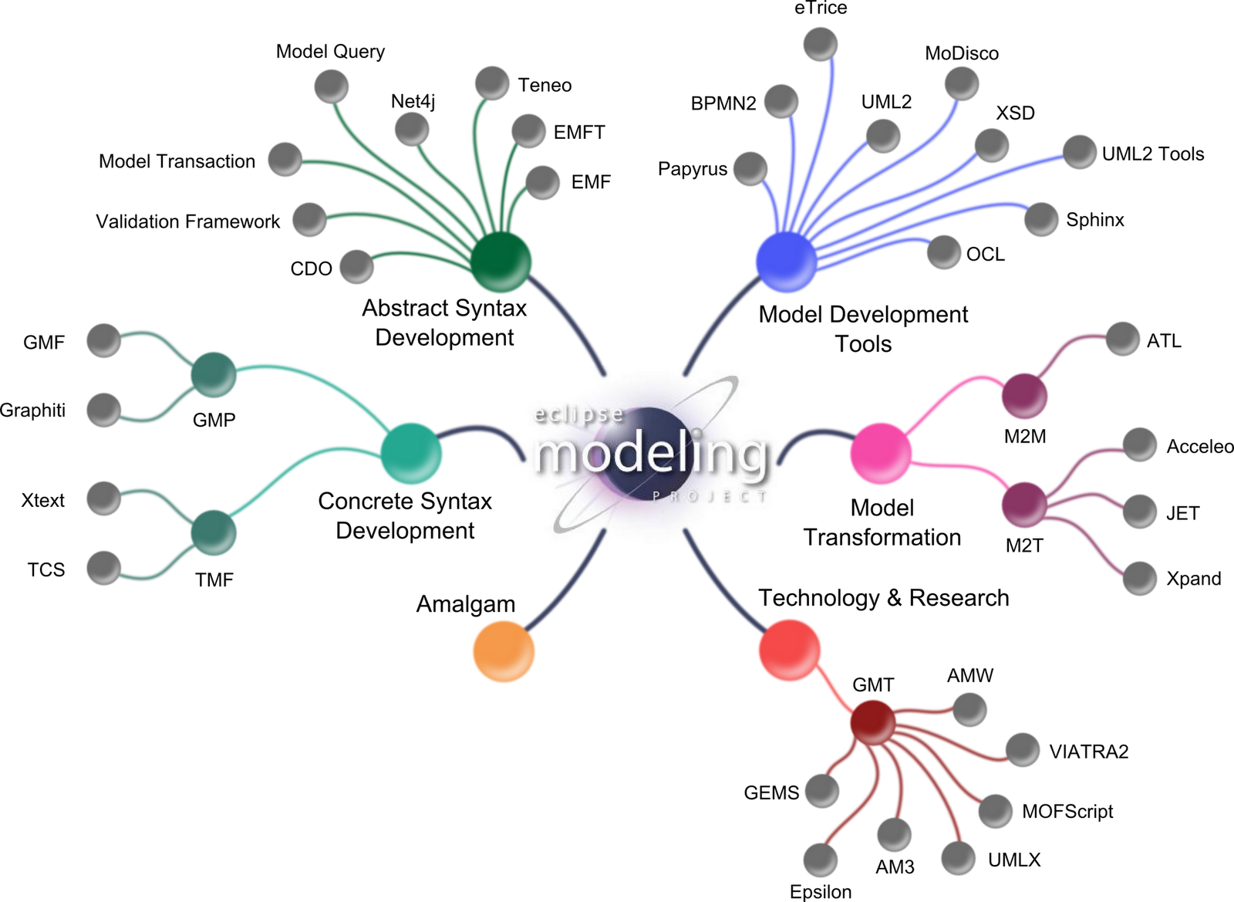
Eclipse Modeling Project
GEMOC

Slide 39
Ecore/EMF
EMF serves as the foundation: It provides the Ecore meta-metamodel (basically a Class diagram ), and frameworks and tools around it :
EMF provides almost for free (among other features)
serialization (XMI)
Tree editor
either reflective, or generated with possibility to customize
Edition support (outline, notification API for other editors, …)
Java manipulation API
EMF compatible projects use this as a base to propose extended services

Slide 40




Metamodeling approach
Language Engineers
Language Users
Viewpoint
(graphical editor)
Grammar
(textual editor)
Behavioral
semantics
(animator)
Domain
Globalization,
execution,
simulation and
animation
Data
Views and
static checking
Textual editing and
static checking

Slide 41
Metamodeling approach
Language Engineers
Language Users
Domain
Data

Slide 42
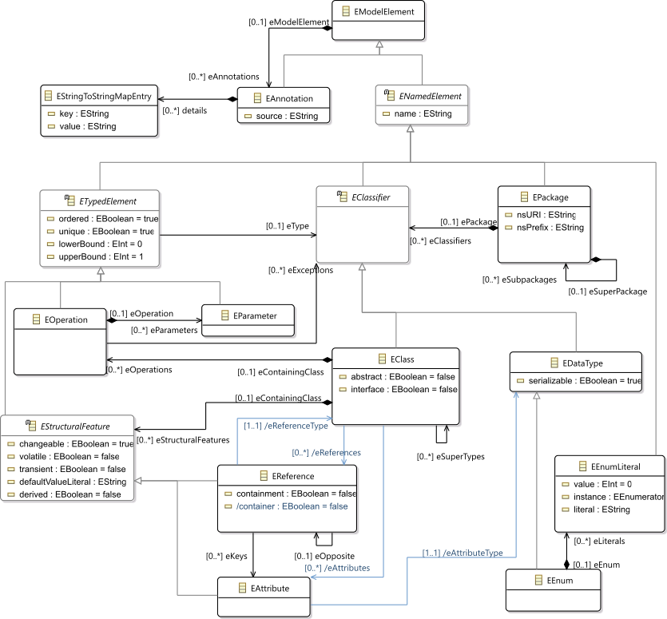
Ecore most used concepts
(ie. Removed most helper derived features, operations and generic support)

Slide 43
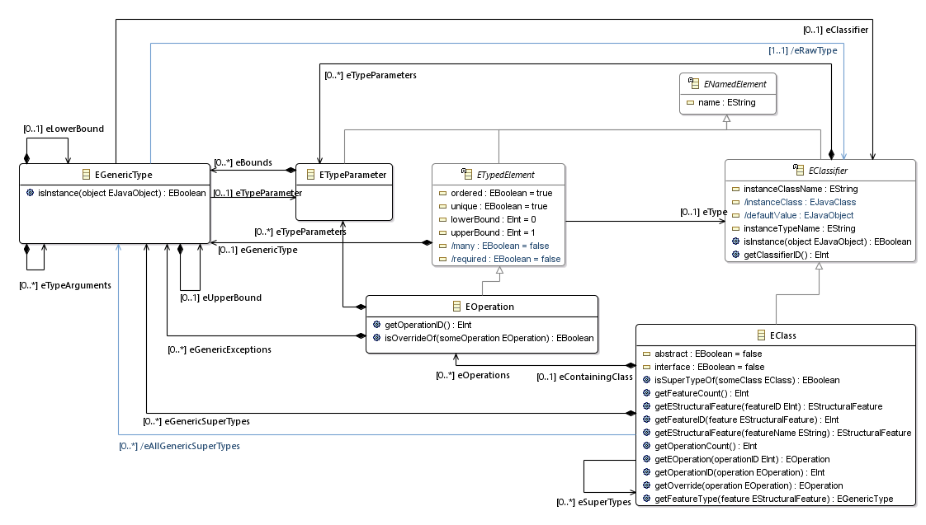
Ecore extended usage
Support of generics
TODO Add usage picture in the tree editor

Slide 44
Design your domain
Using the Ecore tree editor (EMF)
Using the graphical editor (Ecore tools)
Using a textual editor (oclinecore, …)

Slide 45
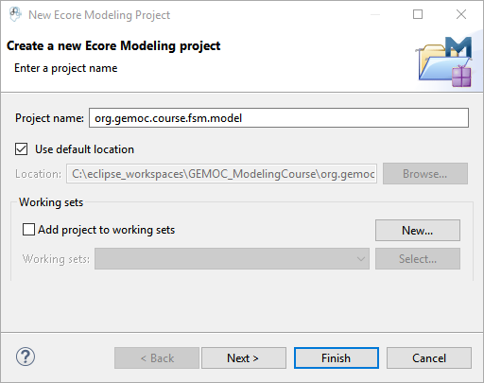
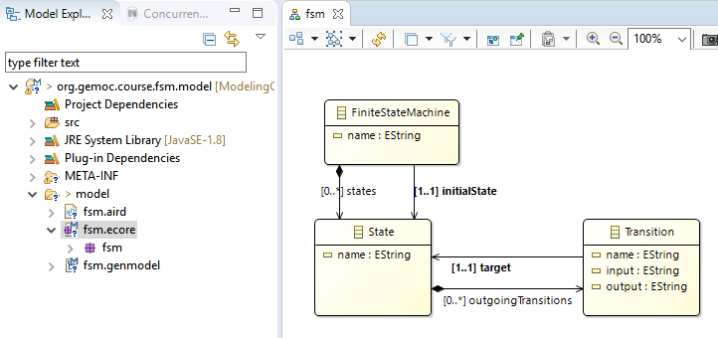
Create the following "ecore modeling project" with these concepts

Slide 46
Containment
A metamodel is not only a graph
Containment information is used by many tools to provide "smart" default implementations
Tree editor, textual syntaxes, graphical syntaxes, …
Impact on model manipulation/transformation

Slide 47
Graph with constraints : assignment example
Composition
Association
A
b
B
C
c
d
D
0..1
1
*
container()
c
a1:A
b
b1:B
c1:C
d
d1:D
a2:A
d2:D
a2.b := b1
d2.c := c1
a1:A
b
b1:B
c1:C
d
d1:D
c
a2:A
container()
d
d2:D

Slide 48
Basic tree editor
For free with EMF
Structure also used as outline for other editors
Customizable via
genmodel
replacement of default icons
Modification of the generated code
For example for custom labels or conditionnal icons
Do not forget to add "generated NOT" in the method comment

Slide 49
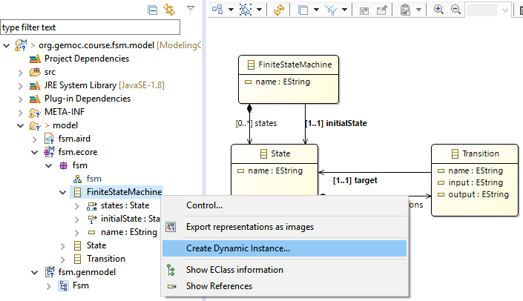
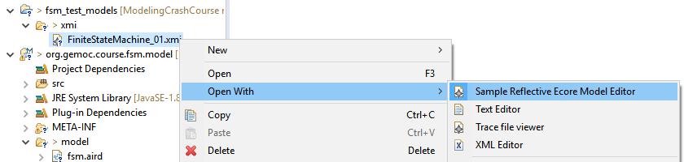
Create a sample model in current workbench
Creates an XMI either in a test folder of your project or in a separate project
Open with the Reflective editor

Slide 50
OCL
Class diagram structure implies design choices
Inviariant (written in OCL for ex) can complement it in order to enforce the consistency of models

Slide 51
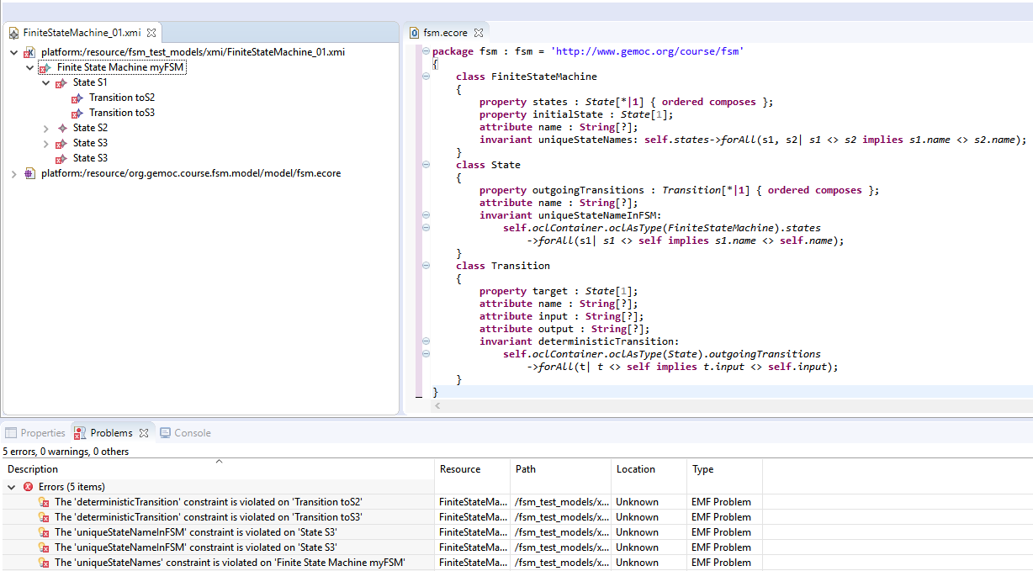
Open fsm.ecore in text editor and add some constraint
OCLInEcore
For example: check name uniqueness
context FiniteStateMachine
invariant uniqueStateNames:
self.states->forAll(s1, s2| s1 <> s2 implies s1.name <> s2.name);

Slide 52
Metamodeling approach
Language Engineers
Language Users
Grammar
(textual editor)
Domain
Data
Textual editing and
static checking

Slide 53
M³
EBNF
Metametamodel
Grammar
Metamodel
M²
M¹
Source
Code
Model

Slide 54

Give me a grammar,
I’ll give you (for free)
* a comprehensive editor (auto-completion, syntax highlitening, etc.) in Eclipse
* an Ecore metamodel and facilities to load/serialize/visit conformant models (Java ecosystem)
* extension to override/extend « default » facilities (e.g., checker)

Slide 55
Bridging grammar/model space

Slide 56

Xtext, Grammar, Metamodel
Xtext, Grammar, Metamodel
Grammar
Metamodel
conforms To
conforms To
Source Code
A
Model A

Slide 57
TODO add grammar mapping

Slide 58



Generate text editor

Slide 59


Adapt grammar
Add EcoreAutoRegister to help removing errors

Slide 60

Test in a runtime workbench

Slide 61

Try the text editor

Slide 62

Improve text editor outline
Genmodel : generate edit
Change icons
Adapt labels

Slide 64
Metamodeling approach
Language Engineers
Language Users
Grammar
(textual editor)
Viewpoint
(graphical editor)
Domain
Data
Textual editing and
static checking
Views and
static checking

Slide 65
Bridging grammar/model space

Slide 66




Sirius : Principles
Language desugner/developers
Final User
Specification environment
Runtime environment

Slide 67

Sirius: Examples of Viewpoints
….

Slide 68


Slide 69




Create viewpoint

Slide 70


Xtext + Sirius
Model can be edited on both editors

Slide 71
Metamodeling approach
Language Engineers
Language Users
Grammar
(textual editor)
Viewpoint
(graphical editor)
Behavioral
semantics
(animator)
Domain
Views and
static checking
Globalization,
execution,
simulation and
animation
Textual editing and
static checking
Data

Slide 72
Add behavior / write transformation
This is usually a traversal task navigating in the model in order to perform some actions in one or more pass
Adding operations (with "generated NOT") in the ecore gives a nice structuration based on the metamodel concepts
BUT this breaks the separation of concern requirement
Traditional approaches : visitor design pattern
EMF proposes in the model java implementation a pre built variant of the visitor pattern : switch
However, it doesn't scale up very well in case of multiple metamodels; and is

Slide 73
Kermeta
Can be considered as an advanced visitor pattern but with an aspect oriented syntactic sugar
Ie. The programmers see the classes as if they where "reopened" and extended
Extension supports new operations but also new attributes, new association or new inheritance

Slide 74
Melange
2 roles:
Language definition,
Compose languages part in order to build language implementation

Slide 75


Melange simpliest example
Define a language based on an ecore
Everything is in a single ecore
The model type (MT) is equal to the ecore

Slide 76


Melange – Combining language parts
Adds operation and attributes
may add new concepts too by using multiple ecore files (possibly with operator such as slice)
Melange generates the new resulting implementation
We may consider only the result to build additional tooling and ignore the initial parts (which have been copied in the new runtime)

Slide 77


Melange – language relation
Inheritance (implicit or explicit)
Support for convertion services (adapter)
An XSFSM model can be processed by transformation written for FSM
A FSM model can be loaded as XSFSM
Adapter mechanism provides an equivalent to a "downtype copy" but working on the actual FSM model
Must take care to default values
Editor may be written on FSM and animator on XSFSM

Slide 78



Behavior with Melange and K3

Slide 79



Slide 80




Slide 81



Slide 82

Implement the behavior
New attributes or refrences

Slide 83

New operations

Slide 84


Generate the language extended implementation and adapters
Generate the trace support (require for forward/backward debugging)

Slide 85


Debug models

Slide 86
GEMOC graphical animator
Actually a Sirius viewpoint layer based on the executable version of the language

